Slide 1


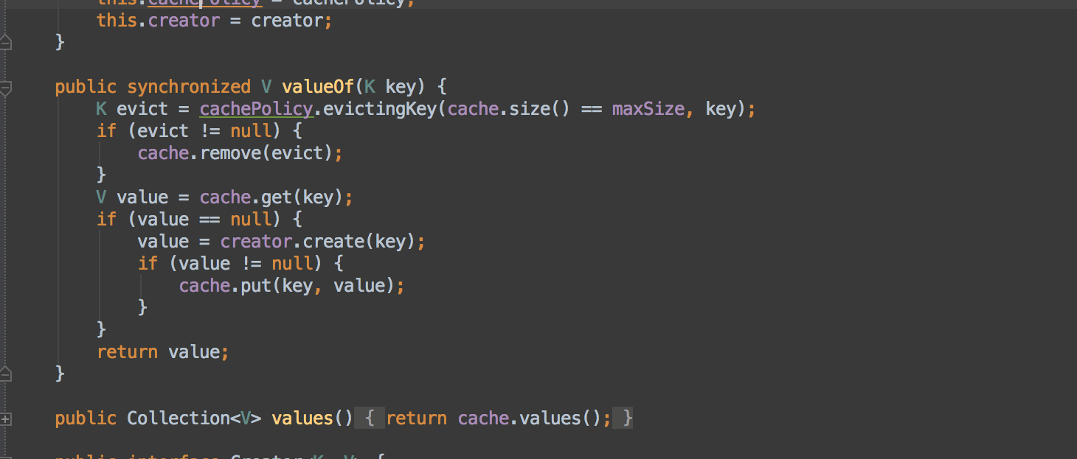


Functional Programming
Data Aggregation and Nested Queries
Advanced
C#
Ivan Yonkov
Technical Trainer
Software University
http://softuni.bg

Slide 2



Table of Contents
LINQ Performance Benchmarks
Data Grouping
Group By Clause
Nested Queries
Declarative
SelectMany()
λ

Slide 3

LINQ Performance Benchmark

Slide 4
LINQ Performance Benchmark
LINQ extension methods extend all implementations of IEnumerable<T> in a consistent manner
Because of the above interface all the extended collections can be enumerated
The extension methods use the enumeration property in order to do their work
E.g. to determine the count of the collection, LINQ’s Count() method enumerates the collection
The methods in most cases are not adapted to the specifics of the concrete collection they are called on

Slide 5
LINQ Performance Benchmark (2)
Calling directly Count property on lists takes only one step
Alternatively Count() extensions method is slower
Stopwatch sw = new Stopwatch();
sw.Start();
int cnt = nums.Count; // 10M elements
sw.Stop();
Console.WriteLine(sw.Elapsed);
00:00:00.0000034
sw.Start();
cnt = nums.Count();
sw.Stop();
Console.WriteLine(sw.Elapsed);
00:00:00.0012423

Slide 6
LINQ Performance Benchmark (3)
LINQ’s Count() Source code
https://github.com/dotnet/corefx/blob/master/src/System.Linq/src/System/Linq/Count.cs
using (IEnumerator<TSource> e = source.GetEnumerator())
{
checked
{
while (e.MoveNext()) count++;
}
}

Slide 7
LINQ Performance Benchmark (4)
Taking value by key in dictionary takes only one step
Alternatively FirstOrDefault() extension method is slower
sw = new Stopwatch();
sw.Start();
string name = names["name_1000"]; // 10k names
sw.Stop();
Console.WriteLine(sw.Elapsed);
00:00:00.0000667
sw.Start();
name = names.Keys.FirstOrDefault(k => k == "name_1000");
sw.Stop();
Console.WriteLine(sw.Elapsed);
00:00:00.0005525

Slide 8
LINQ Performance Benchmark (5)
LINQ’s FirstOrDefault() Source code
https://github.com/dotnet/corefx/blob/master/src/System.Linq/src/System/Linq/First.cs
Tries to use the default ordering, otherwise flattens it
OrderedEnumerable<TSource> ordered = source as OrderedEnumerable<TSource>;
if (ordered != null) return ordered.FirstOrDefault(predicate);
foreach (TSource element in source)
{
if (predicate(element)) return element;
}

Slide 9

Data Grouping

Slide 10
Data Grouping
Data grouping is a concept of aggregation by association
The concept is available in any data manipulation tools and data storages e.g. Databases
Most of the popular databases are using a declarative language called SQL
SELECT FirstName, LastName, Age FROM Students
FirstName | LastName | Age
Pesho | Petrov | 22
Dragan | Cankov | 82

Slide 11
Data Grouping (2)
Usually in the previous scenario students can be grouped by certain criteria (e.g. average age by FirstName)
SELECT FirstName, AVG(Age) FROM Students GROUP BY FirstName
FirstName | AVG(Age)
Ivan | 28
Petar | 26
Georgi | 24
Maria | 18

Slide 12
Data Grouping (2)
Grouping can be applied on a data collection using the GroupBy extension method or the group keyword
After the group keyword is the value which should be added to that particular group
The by clause denotes the key (association) in which the data should be grouped by
from {rangeVariable} in {collection}
group {value} by {key}
into {groupVariable}
select {groupVariable}

Slide 13
Data Grouping (3)
For instance if the task is to group collection of cities by their first letter:
After the group keyword should be each city in that group
After the by clause should be the condition (first letter of that city)
var citiesByLetter =
from city in cities
group city by city[0]
into citiesWithLetter
select citiesWithLetter;

Slide 14
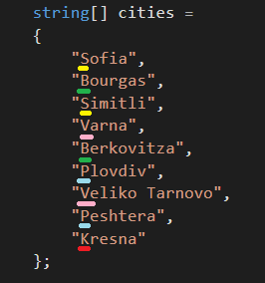
Data Grouping (4)

Slide 15
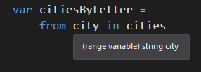
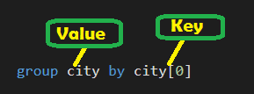

Data Grouping (5)

Slide 16
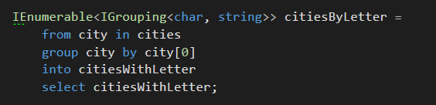
Data Grouping (6)

Slide 17
Data Grouping (7)
The previous code results into an enumerable collection of groups.
Each group consists of
A char as a key (the first letter of the city)
Enumerable of strings (each city that starts with that letter)
The collection can be enumerated. Each value will be a group
The group
Has a Key property – the first letter (char)
Can be enumerated to return each city name

Slide 18
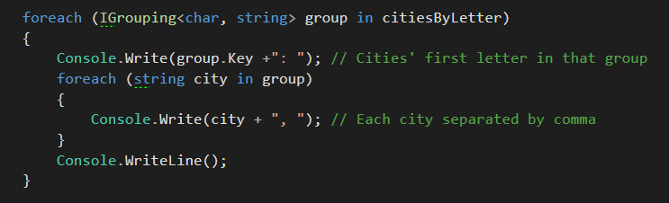
Data Grouping (8)

Slide 19
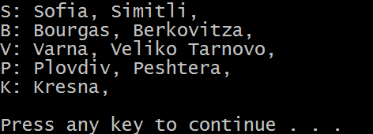
Data Grouping (9)

Slide 20
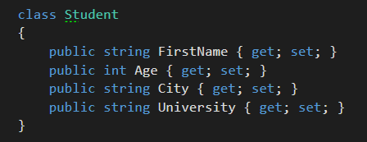
Data Grouping (10)
Let’s make the grouping from the first slides – Average Age of Students by their first name
We have the following definition of a Student class

Slide 21
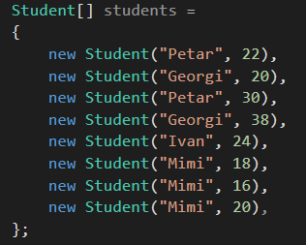
Data Grouping (11)
And the following collection
Petar (22+30)/2 = 52/2 = 26
Georgi (20+38)/2 = 58/2 = 29
Ivan (24)/1 = 24
Mimi (18+16+20)/3 = 54/3 = 18

Slide 22
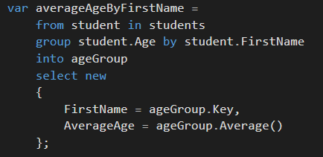
Data Grouping (12)
We need to group Age by FirstName
The result will be key FirstName and enumerable of Age’s
Then we need to aggregate Enumerable of Ages to their Average
An anonymous object can be returned instead of IGrouping

Slide 23
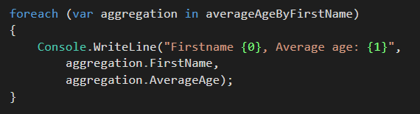
Data Grouping (13)
The result will be Enumerable of Anonymous objects
The resulting Enumerable can be enumerated and each anonymous object printed

Slide 24
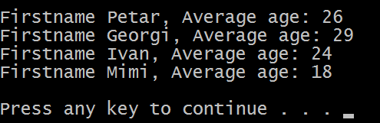
Data Grouping (14)
The result is as expected

Slide 25
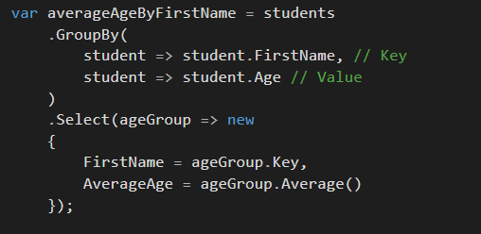
Data Grouping (15)
The functional approach will require GroupBy method
The abstraction of the delegate is:
Func<Student, StudentKey>, Func<Student, StudentValue>

Slide 26

Nested Queries

Slide 27

Nested Queries
Very often we need to deal with the collection matching problem
To sort an array
To find products in one shop that are not present in any other
To find how many people in collection of people are dating any of the rest of the collection
And we will talk about the last one
The Student definition is expanded with a string property holding the name of their current date

Slide 28
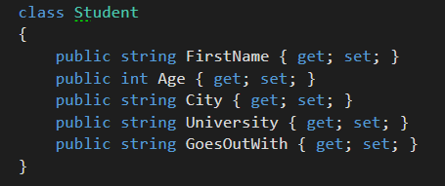
Nested Queries (2)
The Student definition now looks like
The GoesOutWith property holds the FirstName of another Student instance in the pool

Slide 29
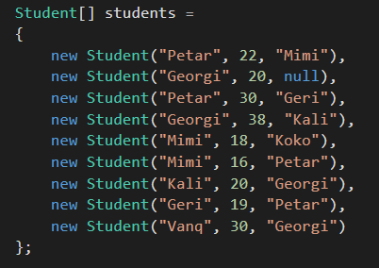
Nested Queries (3)
The students collection now has students with their dates

Slide 30
Nested Queries (4)
Our task is to get each student and find all other students that goes out with this student (or at least with its FirstName)
For instance we start traversing the collection with “Petar”
It seems that “Mimi” and “Geri” are dating “Petar”
Then we hit “Georgi”
It seems that “Kali” and “Vanq” are dating student with first name “Georgi” (don’t take in mind that it’s not the same Georgi)
In order to find that out we need to travers the collection over again for each iteration
It’s called a Nested query

Slide 31

Nested Queries (5)
For each range variable student introduce a nested range variable otherStudent to try the matchmaking
Find these otherStudents whose GoesOutWith property is the same as the student’s property FirstName

Slide 32
Nested Queries (6)
The association (key) we will group by will be the student’s FirstName
The values we will push to that association will be the FirstName’s of the otherStudents that dates this student
The result should be a string key and an enumerable of strings as a value

Slide 33
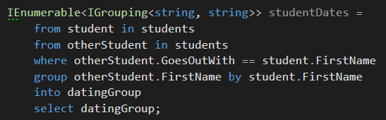
Nested Queries (7)

Slide 34
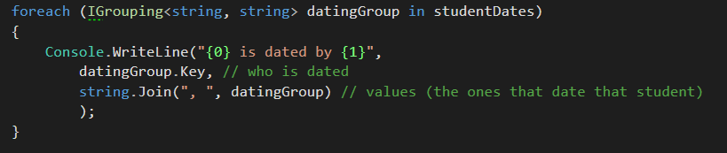
Nested Queries (8)
Enumerate the group collection

Slide 35
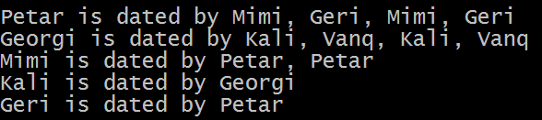
Nested Queries (9)
The result has duplicates because there are some keys twice and the nested query finds their corresponding dates once again

Slide 36
Nested Queries (10)
The same can be achieved via SelectMany() extension method
It takes two delegates as arguments
Func<T, IEnumerable<TC>> collectionSelector
Func<T, TC, TResult> resultSelector
The implementation can be translated to
(rangeVar) => return collection,
(rangeVar, nestedRangeVar) => return resultObject

Slide 37
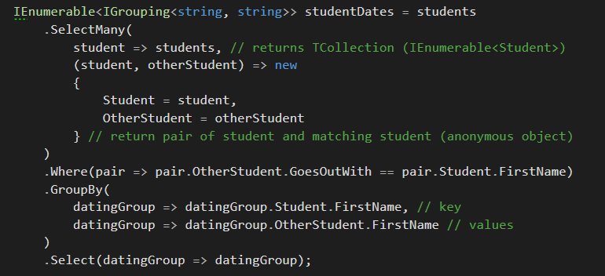
Nested Queries (11)

Slide 38
Nested Queries (12)
The usual implementation of SelectMany() uses nested loops
https://github.com/dotnet/corefx/blob/master/src/System.Linq/src/System/Linq/SelectMany.cs
foreach (TSource element in source)
{
foreach (TCollection subElement in collectionSelector(element))
{
yield return resultSelector(element, subElement);
}
}

Slide 39

Summary
LINQ can be slower if used instead of DS internal functionality
Grouping is setting data under association
Can be used with data aggregation
Nested Queries usually match an element with any other element in the collection
LINQ is open source
Take a look on GitHub

Slide 40








Functional Programming Part 2
https://softuni.bg/courses/advanced-csharp

Slide 41

License
This course (slides, examples, demos, videos, homework, etc.) is licensed under the "Creative Commons Attribution-NonCommercial-ShareAlike 4.0 International" license
Attribution: this work may contain portions from
"Fundamentals of Computer Programming with C#" book by Svetlin Nakov & Co. under CC-BY-SA license
"OOP" course by Telerik Academy under CC-BY-NC-SA license

Slide 42






Free Trainings @ Software University
Software University Foundation – softuni.org
Software University – High-Quality Education, Profession and Job for Software Developers
softuni.bg
Software University @ Facebook
facebook.com/SoftwareUniversity
Software University @ YouTube
youtube.com/SoftwareUniversity
Software University Forums – forum.softuni.bg

